Slide 1
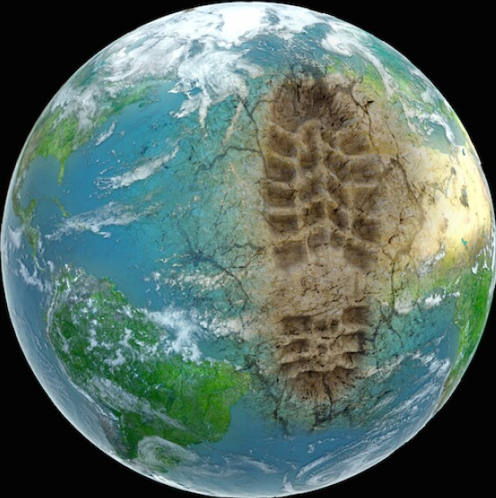
Emerging contaminants & pollutants
Sustainable Planet | 29th April 2025
Prof Sophie Nixon | Chair of Environmental Microbiology and Biotechnology

Slide 2
Intended Learning Outcomes
Differentiate between the terms contaminant and pollutant
Identify and classify a range of emerging environmental contaminants and pollutants
Explain why these substances are of environmental concern
Evaluate current remediation approaches and identify their key limitations and challenges
Connect emerging contaminant issues with relevant SDGs

Slide 3
What we will cover
🌍 The Anthropocene: Defining humanity’s environmental footprint
🔍 Emerging contaminants: What are they and where are they coming from?
🚨 From contaminant to pollutant: When substances become a problem
🧪 Case studies: Plastics and PFAS
🌿 Responding to the crisis: Current remediation & nature-based solutions
📄 Paper of the week: Pharmaceutical pollution in the world’s rivers

Slide 4
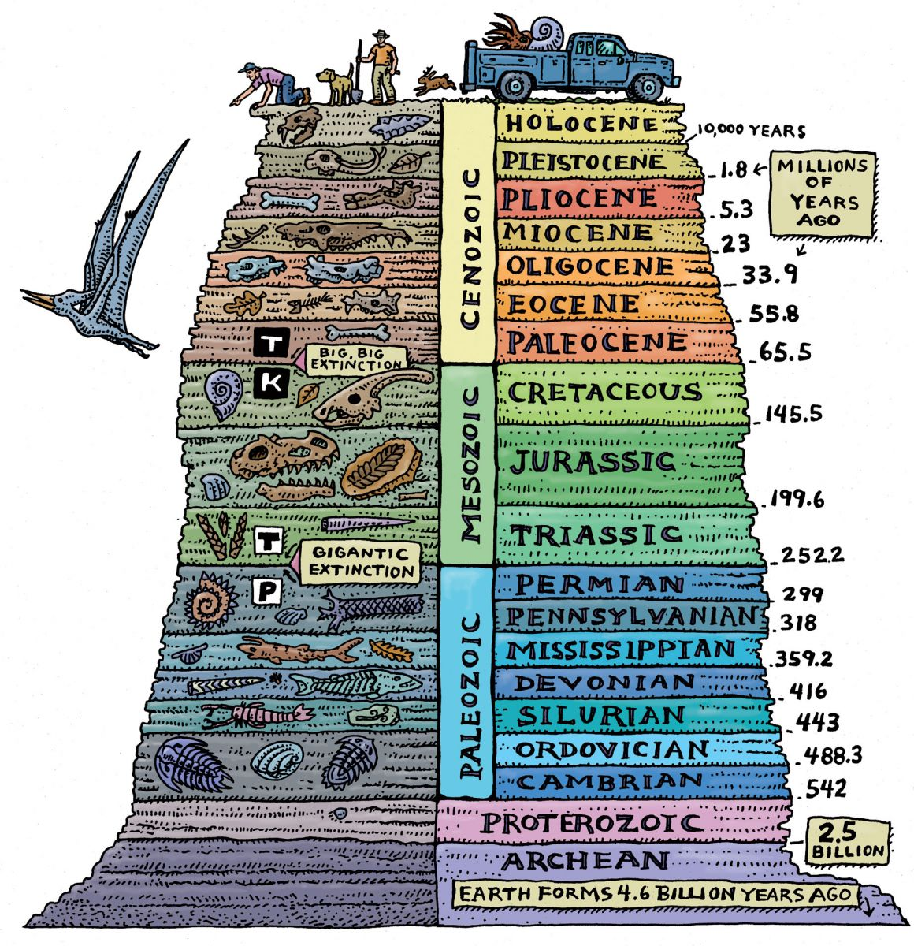
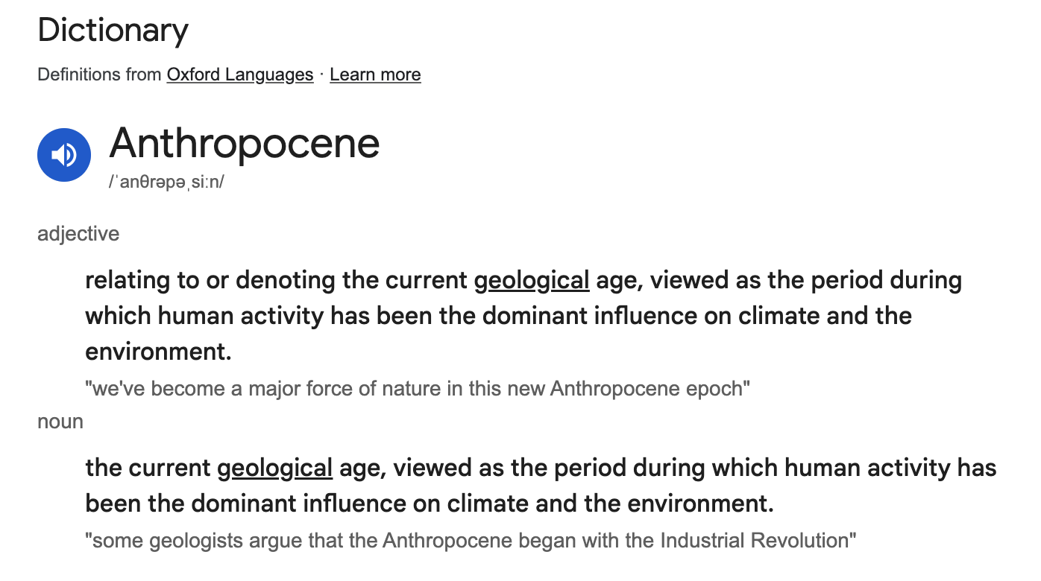
We are in the Anthropocene
The name is a combination of anthropo- from the Ancient Greek ánthropos meaning 'human' and -cene from kainós meaning 'new' or 'recent'.

Slide 5
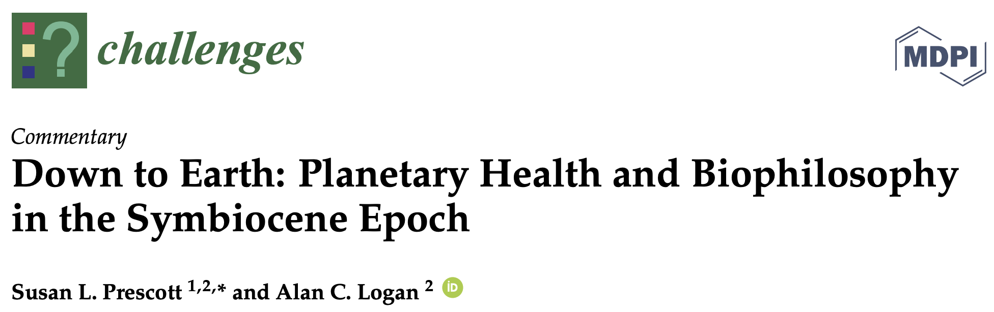
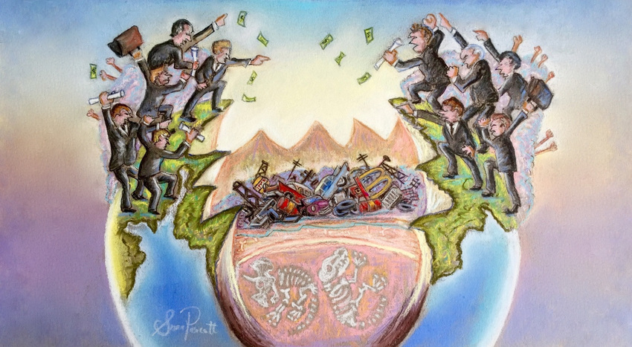
An alternative definition
Anthropocene Syndrome
“a complex of environmental degradation, biological annihilation in the form of species losses, non-communicable disease epidemics, climate change, and increasing incivility in public and professional discourse”
“a set of signs and symptoms that are intertwined with politics, economics, policies (or lack thereof), and social values.”

Slide 6
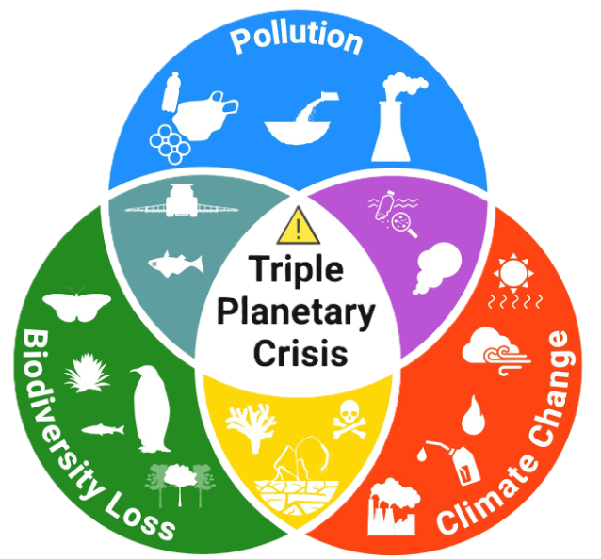
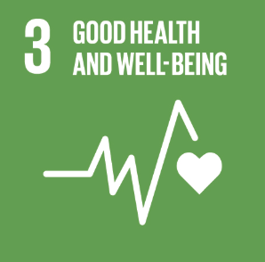
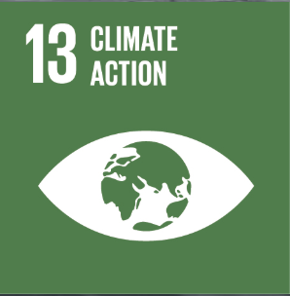
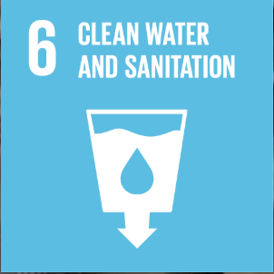
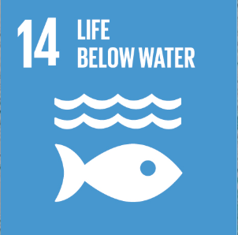
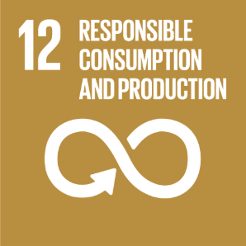
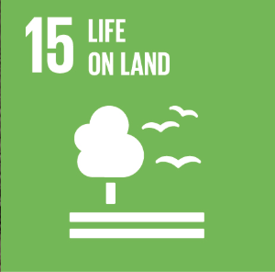
aka the Triple Planetary Crisis

Slide 7
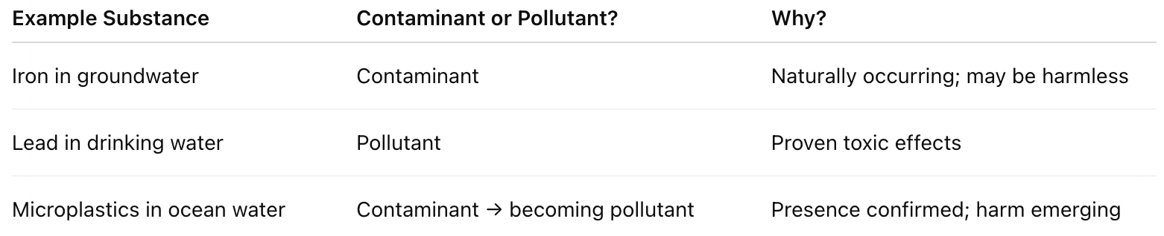
Contaminants vs Pollutants
a contaminant is any physical, chemical, biological, or radiological substance present in the environment at levels that are not naturally occurring, or that are above natural background levels, but that does not necessarily cause harm
UNEP (2021), Making Peace with Nature Report
a pollutant is a contaminant that causes, or is likely to cause, adverse biological, chemical, or physical effects to organisms or ecosystems
The transition from contaminant to pollutant is determined by evidence of harm

Slide 8
Plastics
(macro and micro)

Slide 9
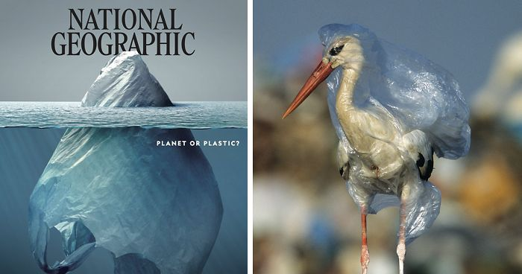

Slide 10

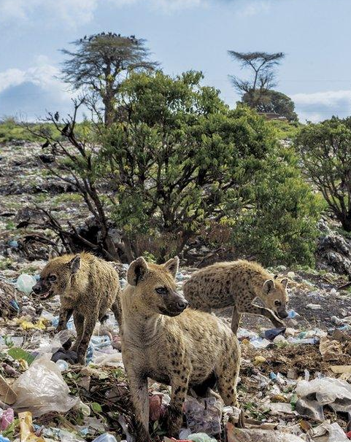
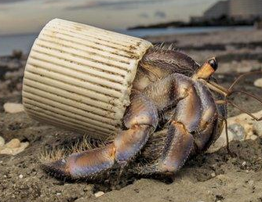
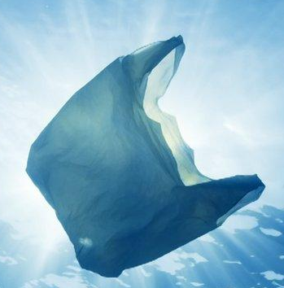

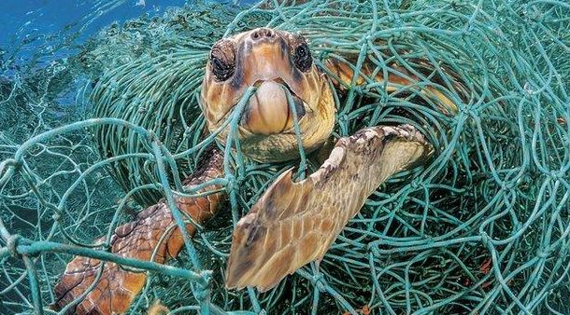

Slide 11
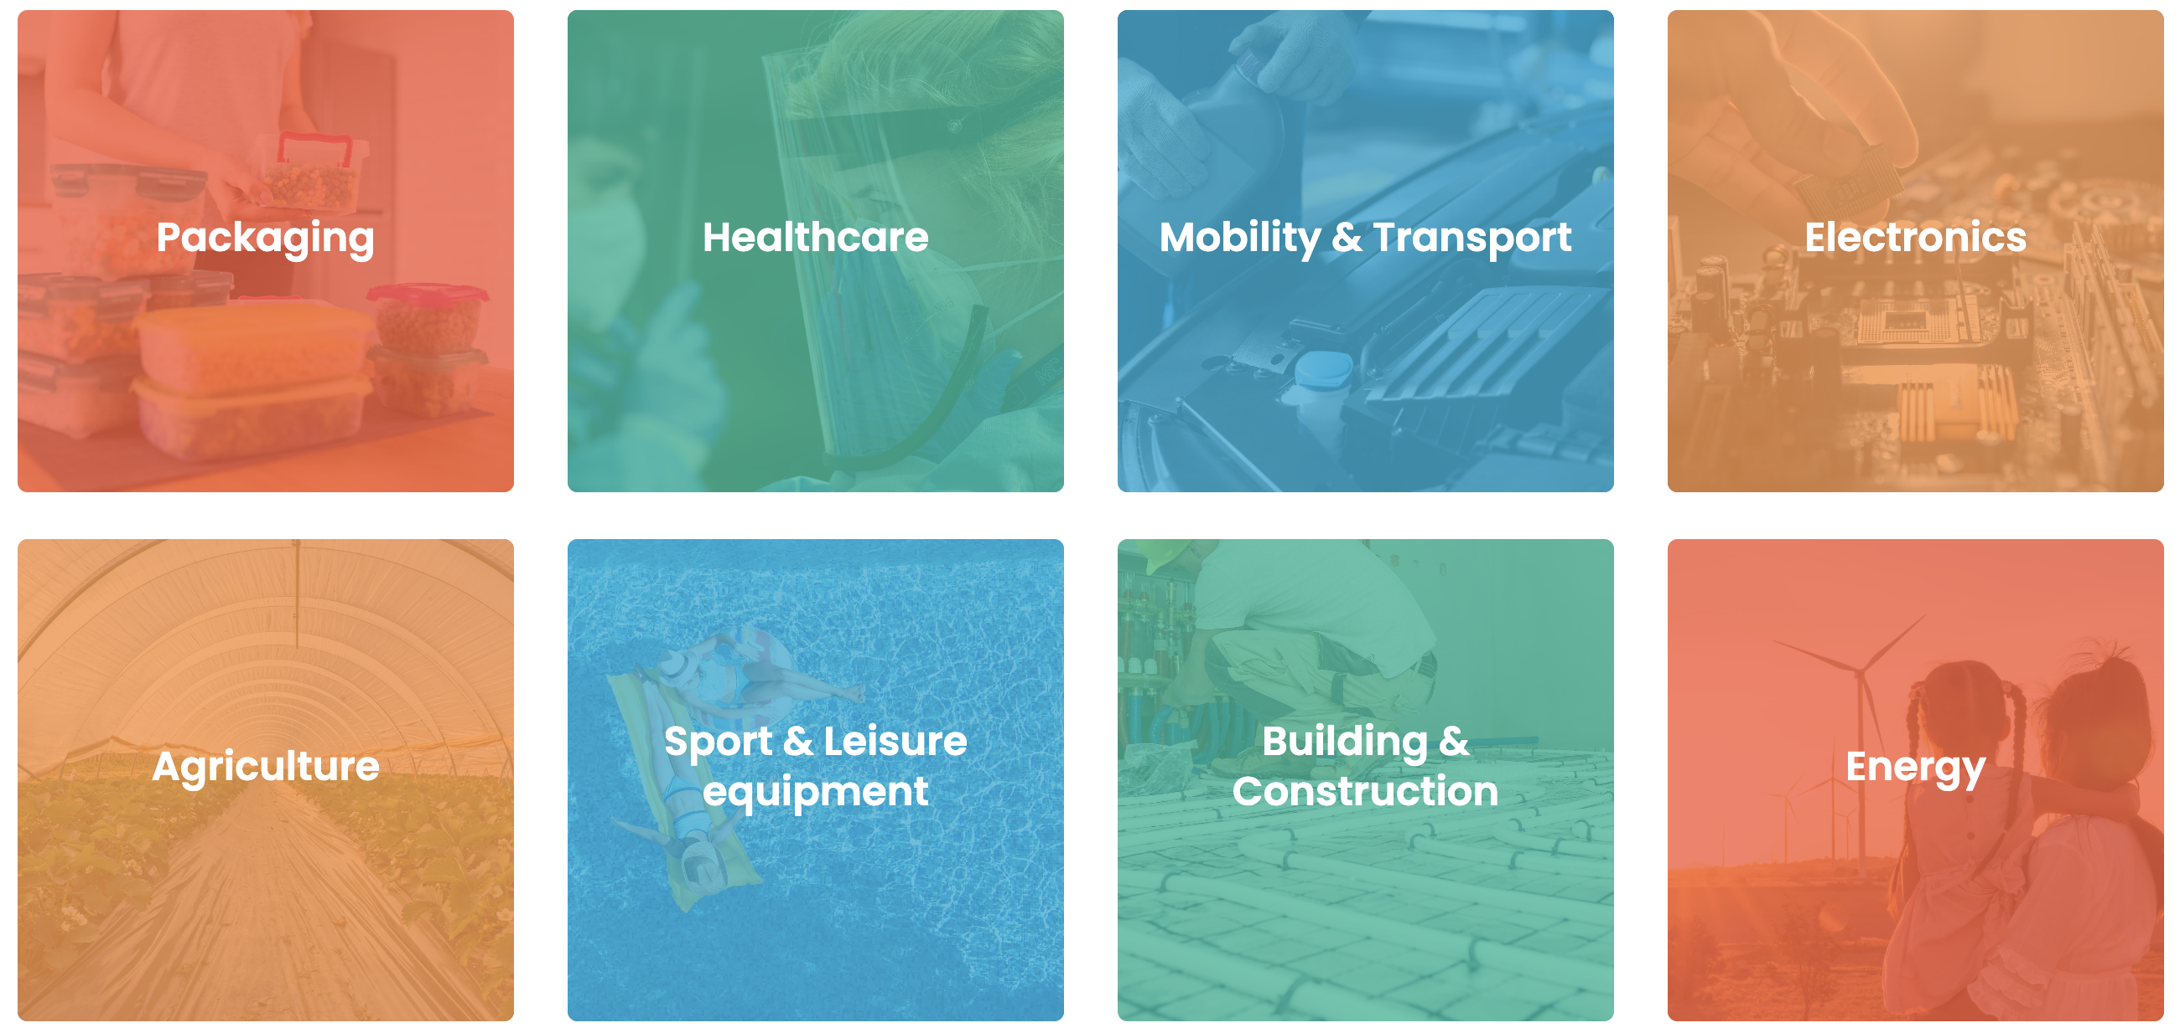
What are plastics?
https://plasticseurope.org
a group of materials produced from natural or synthetically created resources
raw materials used to produce plastics are mostly found in nature, e.g., cellulose, coal, natural gas, salt, and crude oil

Slide 12
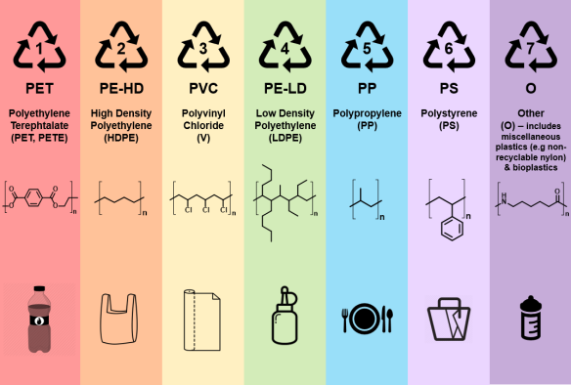
Different plastics and their uses
Resin Identification Code
Resin types are differentiated by Temp heated to

Slide 13

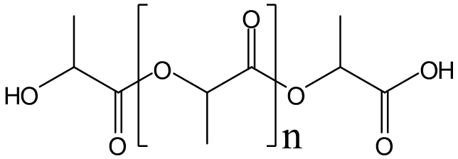
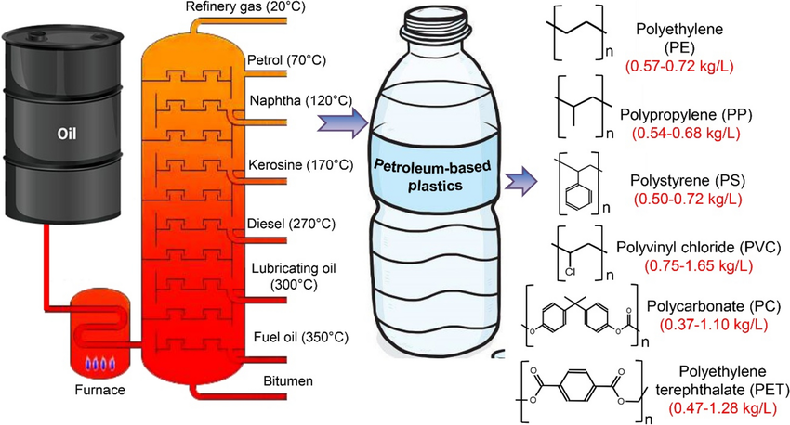
How is it made?
Polylactic Acid (PLA)
aka ‘corn plastics’
Elsamahy et al 2023 Env Monitor Assess 195(11) DOI:10.1007/s10661-023-11955-7

Slide 14
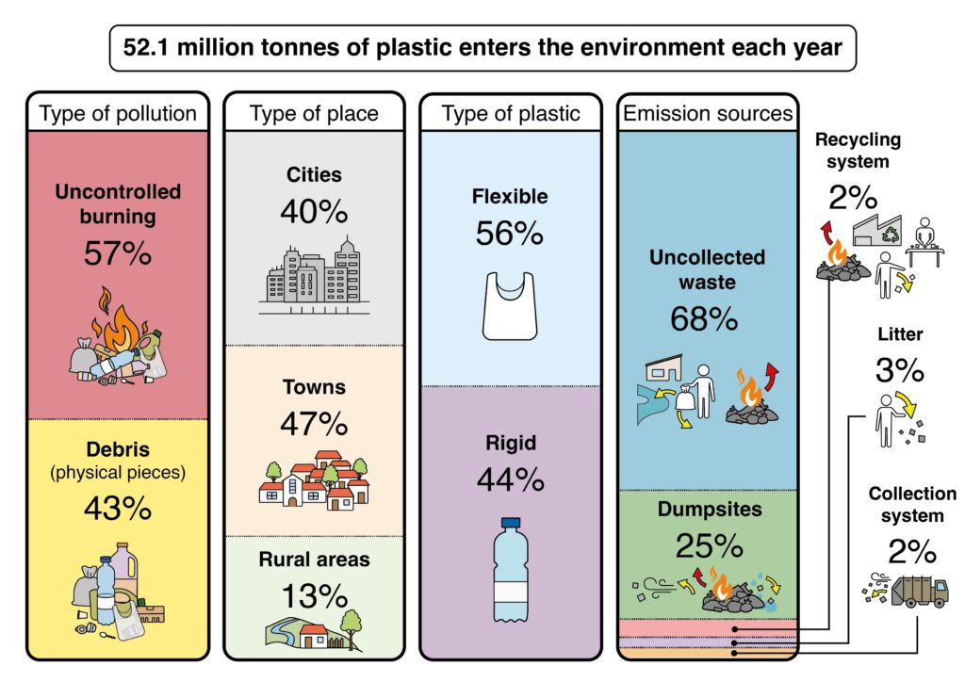


Slide 15
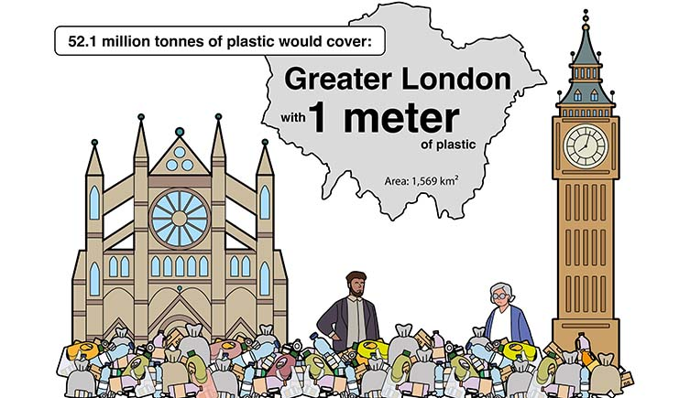

Slide 16
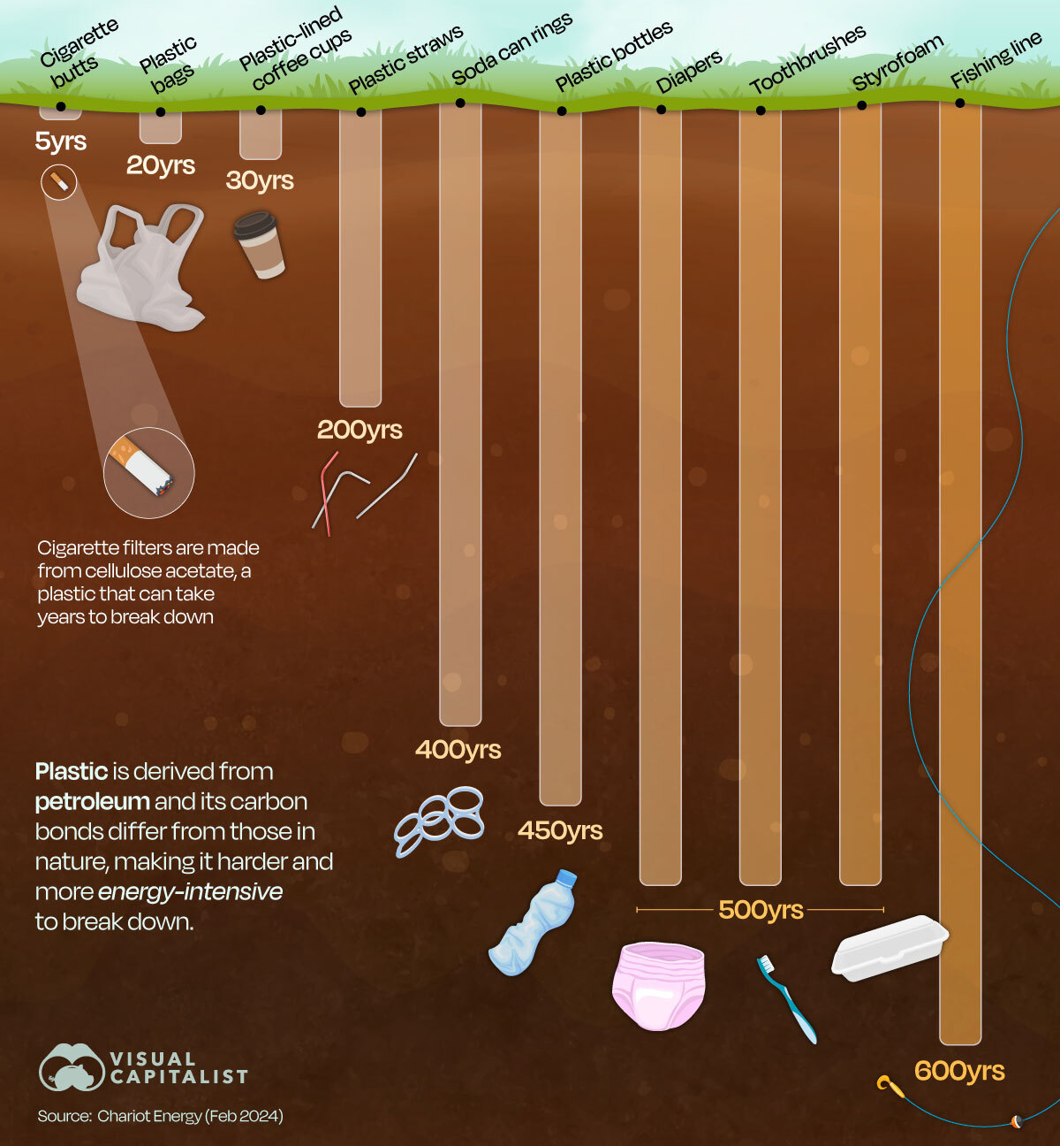
Why is plastic an environmental issue?
Plastics are persistent, lasting for decades to centuries without fully breaking down:
🧪 Strong Chemical Bonds: Long chains of carbon-carbon (C–C) or carbon-hydrogen (C–H) bonds that are very stable and hard to break under natural conditions
🦠 Resistance to Biological Attack: Most microbes and enzymes cannot recognize or break down synthetic plastic polymers; they evolved to degrade natural materials, not human-made ones
💧 Hydrophobicity: Plastics repel water, reducing chemical weathering processes like hydrolysis that would otherwise help degrade them
🧱 Physical Durability: Tough and flexibleeaning they resist mechanical damage, abrasion, and temperature changes that could otherwise help fragment and degrade materials

Slide 17
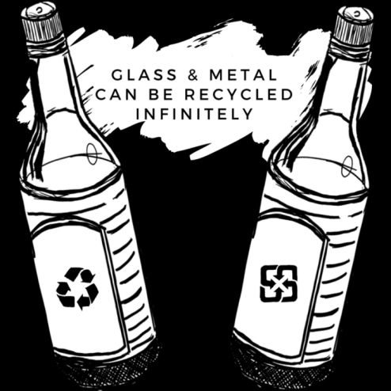
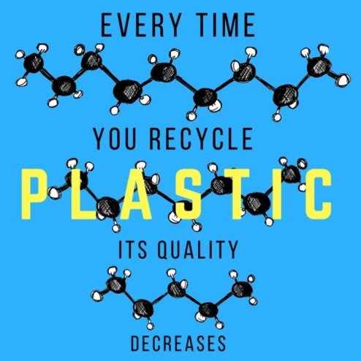
Can’t we just recycle it?

Slide 18
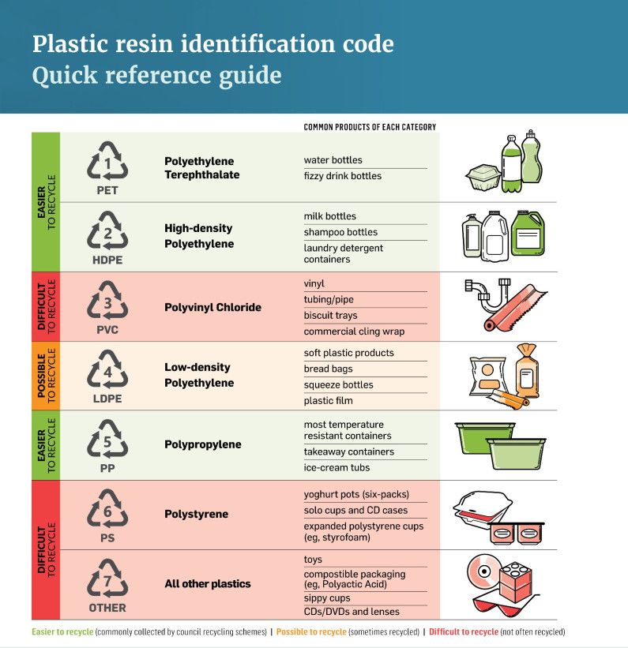
Not all plastics are equally recyclable
https://environment.govt.nz
PET
easily melted and reformed into new products without significant loss of quality
consistent composition, high demand for recycled PET (rPET), and mature sorting infrastructure
HDPE
simple chemical structure and
widespread use in bottles and containers; easy to sort, clean, and reprocess into high-quality recycled materials
PVC
contains several chemical additives that can release toxic substances during processing (e.g. phthalates)
requires complex separation and cleaning steps; costly and environmentally risky compared to other plastics.
PS
lightweight but bulky = inefficient transportation
tends to break into small fragments (microplastics)
often contaminated with food
very low market value when recycled

Slide 19
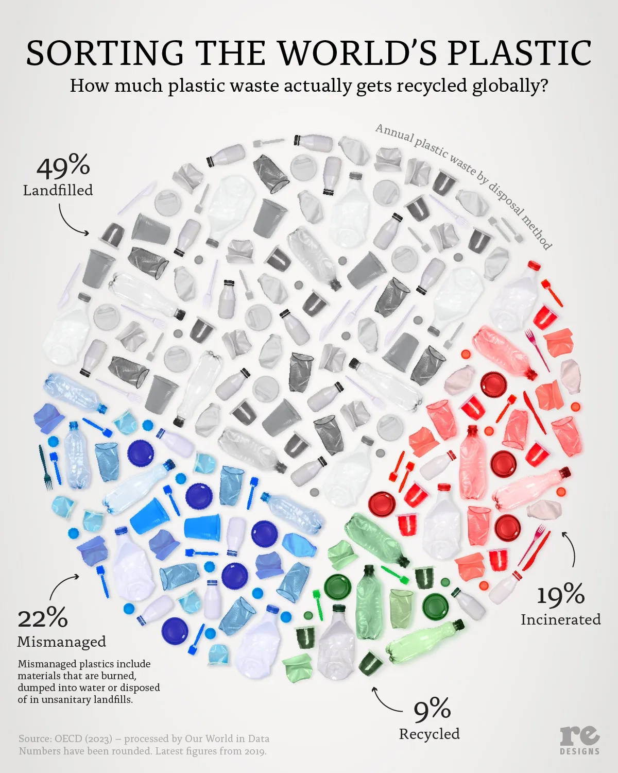
The reality of recycling
Recyclable ≠ Recycled
💸 Cost: Virgin plastic is often cheaper than recycled plastic, reducing demand for recycled plastics
🛑 Infrastructure: Recycling systems vary widely
🚢 Global waste trade: Wealthy nations (e.g. the UK!) export plastic waste overseas, where it may be poorly managed, burned, or dumped rather than recycled
📜 Weak policy and regulation: Without strong legislation or incentives, recycling remains voluntary or economically unattractive for many industries
🔥 Contamination: Mixed or dirty plastics are costly to clean and recycle, meaning much collected material is incinerated or landfilled instead

Slide 20

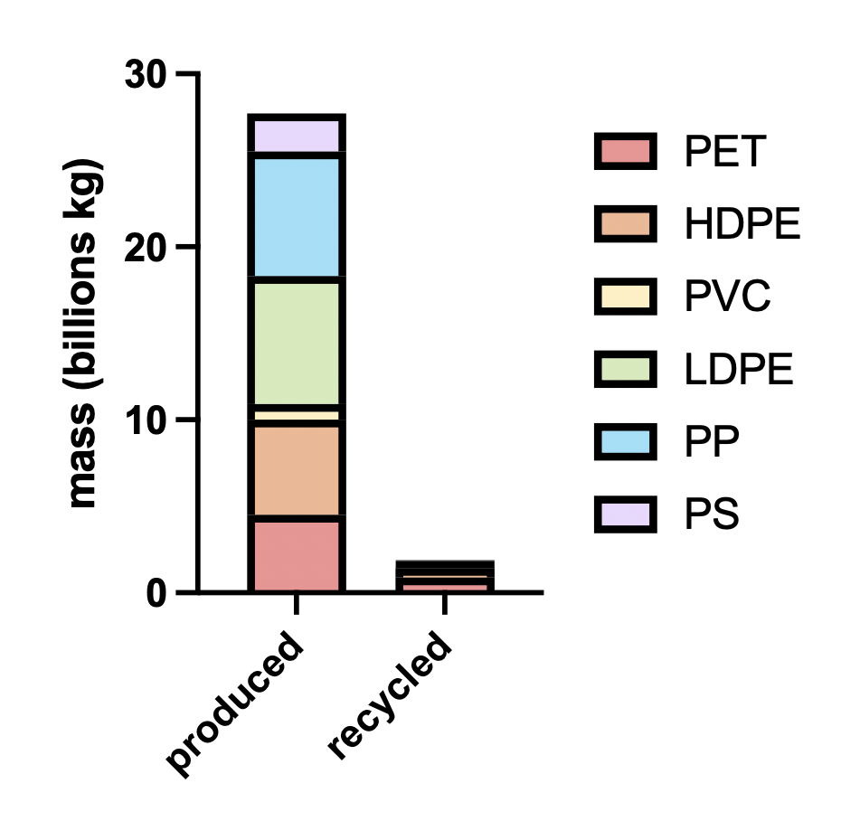
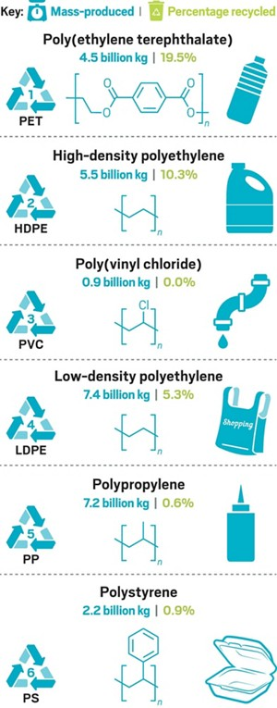
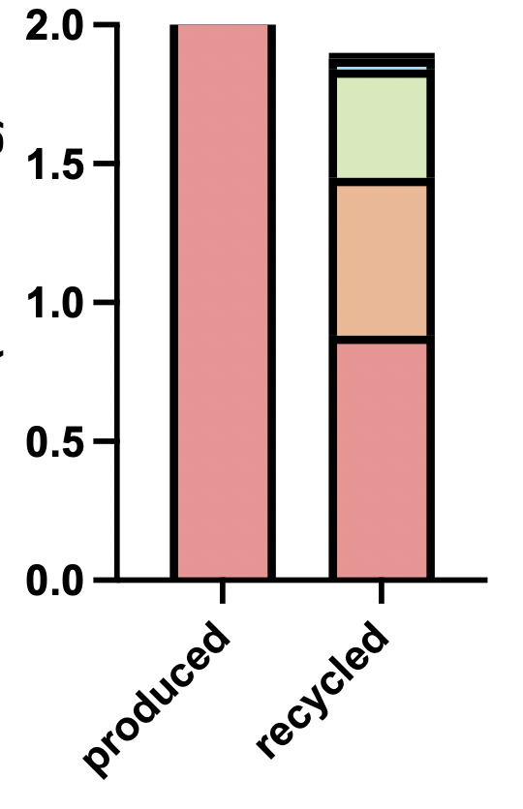
The reality of recycling
Data from the US Environmental Protection Agency, are for the U.S. in 2012, published in 2014.

Slide 21
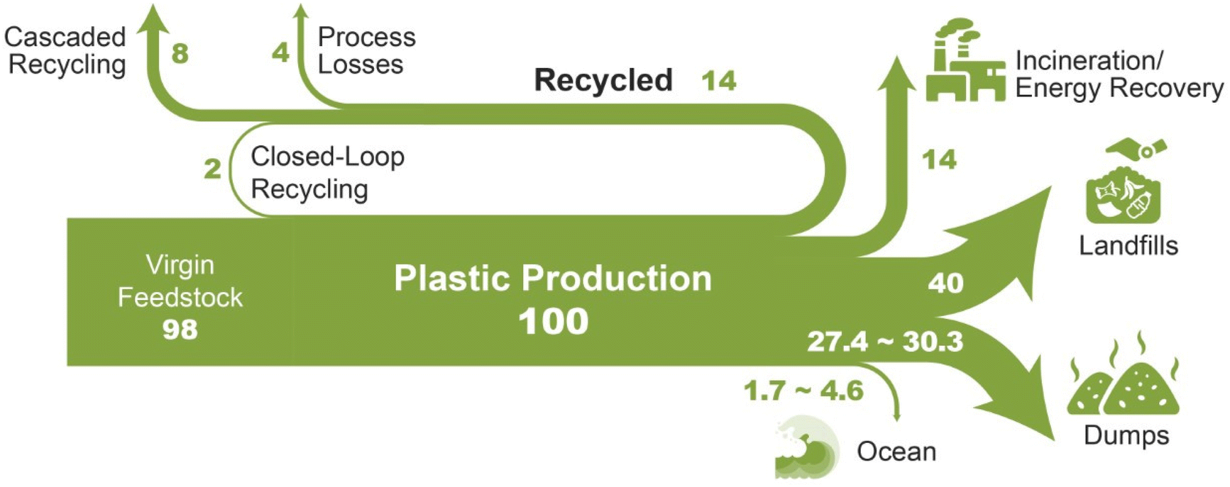
What happens to it?
Li et al (2022) DOI: 10.1039/D2GC02588D Green Chem., 24, 8899-9002

Slide 22
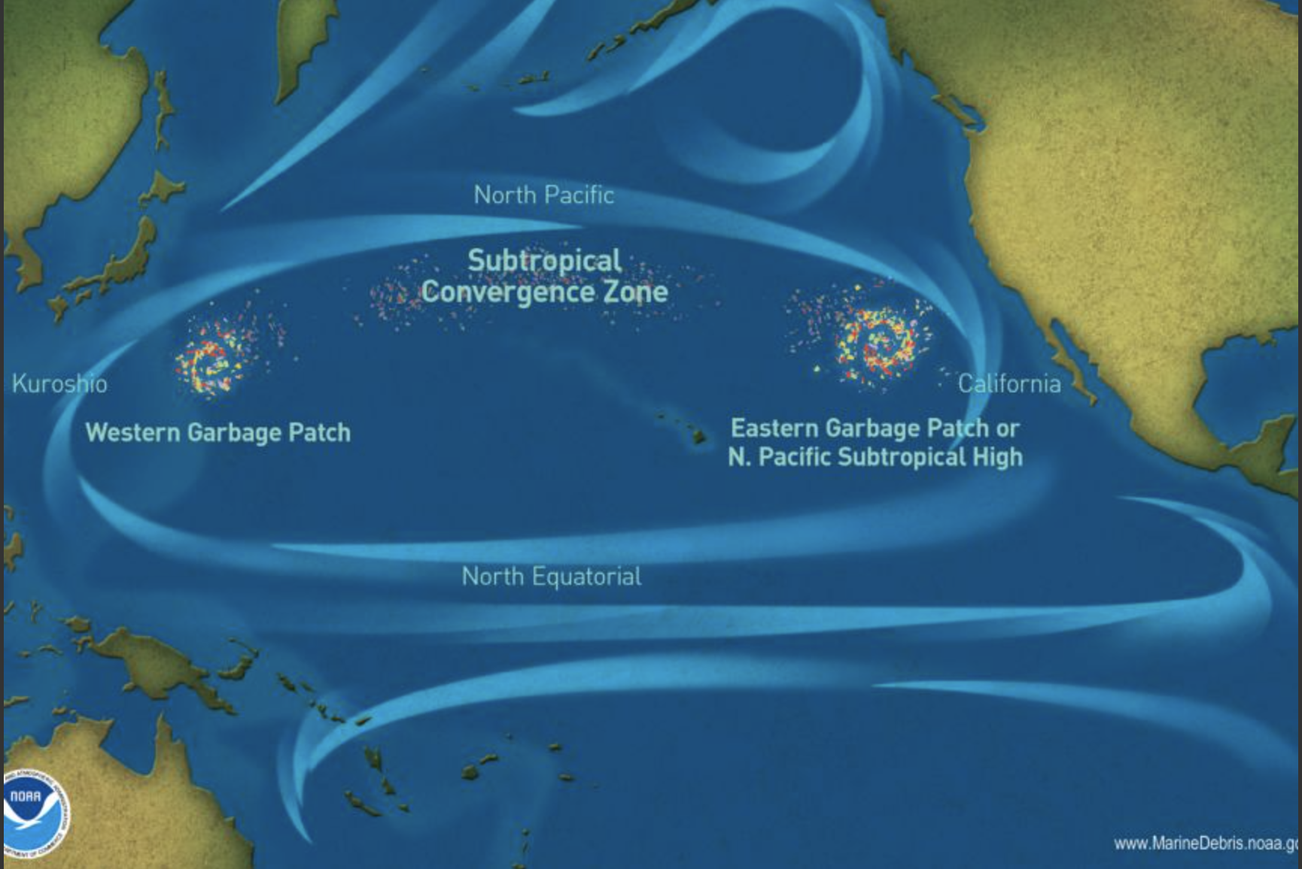
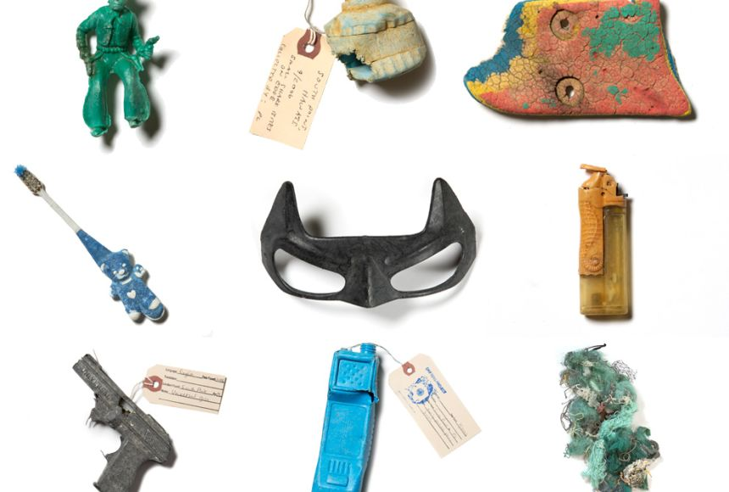
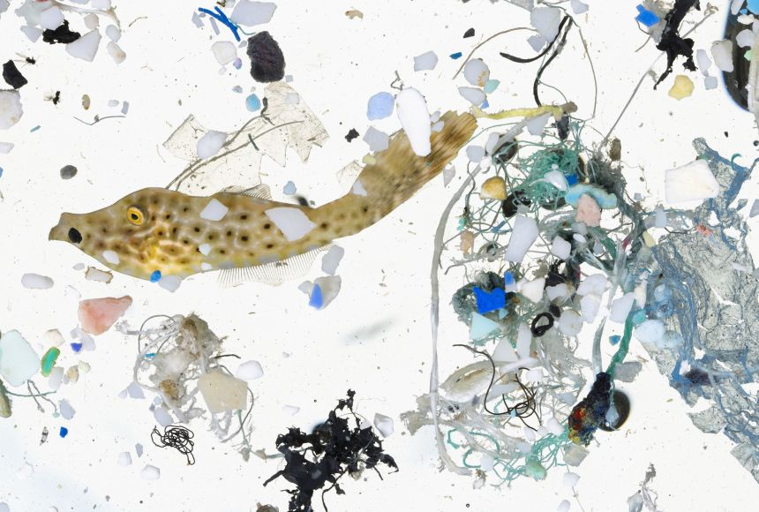
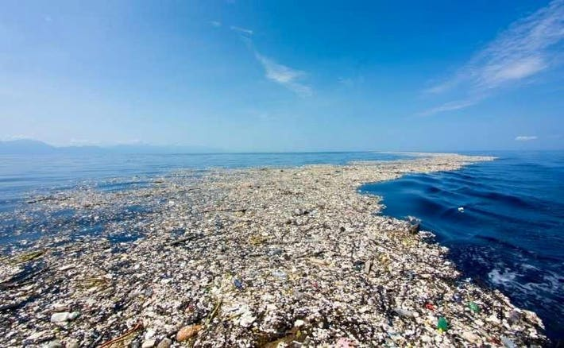
The Great Pacific Garbage Patch
macro-plastics
micro-plastics

Slide 23
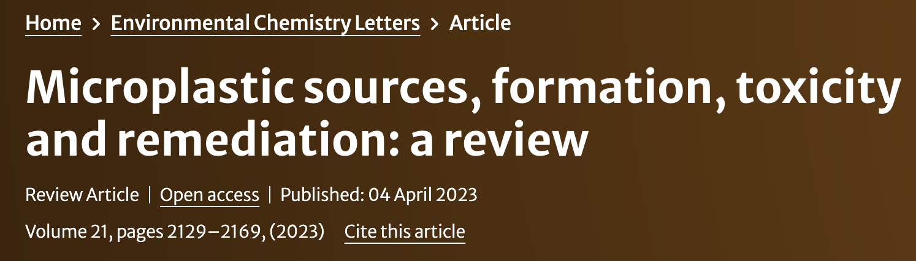
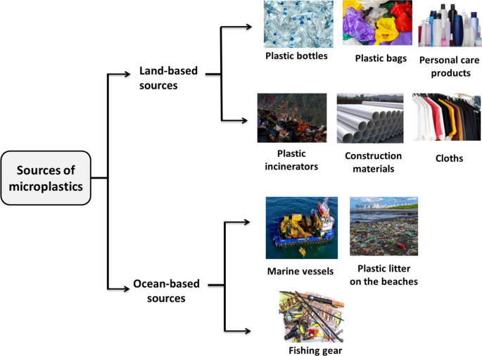
Microplastics
<5 mm
Osman et al 2023
Microplastics mainly come from land-based sources (80–90%) like urban runoff, wastewater, and industrial activities, while ocean-based sources (e.g., fishing activities) account for only 10–20%
They are categorized into primary (e.g., microbeads in cosmetics) and secondary microplastics (breakdown of larger plastics)
They are highly mobile; we find them everywhere…

Slide 24
Microplastics are ubiquitous
🌊 Oceans and Marine Environments
Surface waters
Deep-sea sediments
Coastal beaches and estuaries
Arctic sea ice and Antarctic waters
🏞️ Freshwater Systems
Rivers and streams
Lakes and reservoirs
Groundwater aquifers
🌧️ Atmosphere
Urban and rural air (e.g., airborne microplastics)
Rainwater ("plastic rain")
Snow, including remote areas like the Alps and Arctic
🧊 Cryosphere
Glacier surfaces
Arctic and Antarctic snowpacks
🌱 Soil and Terrestrial Ecosystems
Agricultural soils (especially where sewage sludge is used as fertilizer)
Forest soils
Urban parks and green spaces
🧫 Biological Systems
Marine organisms (fish, mussels, zooplankton)
Freshwater organisms
Terrestrial organisms (insects, birds)
Human bodies (detected in blood, lung tissue, placenta, and faeces)
🏠 Built Environments
Indoor dust (homes, offices, schools…)
Tap water and bottled water
Food products (e.g., seafood, salt, honey…)

Slide 25
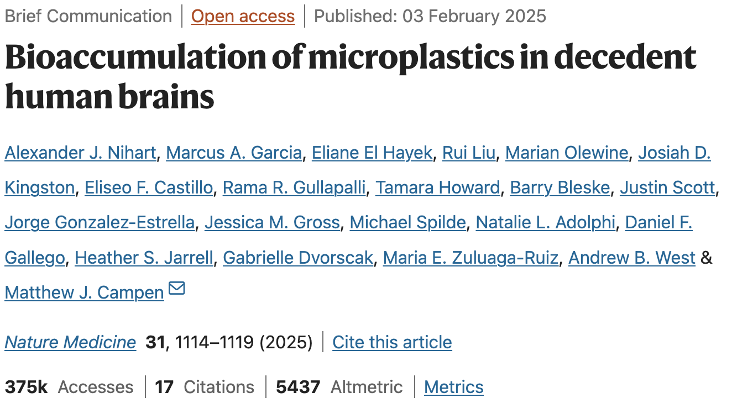
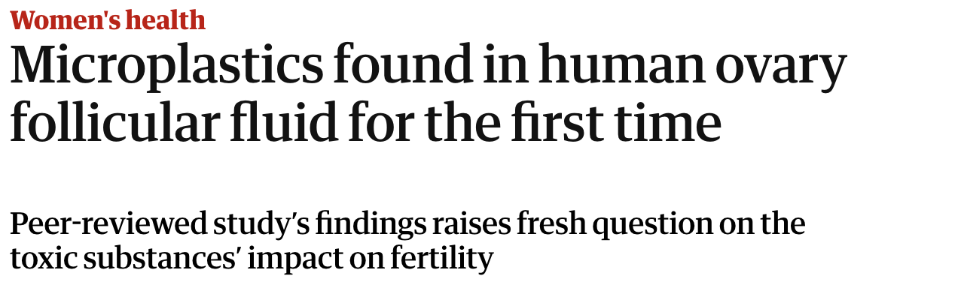
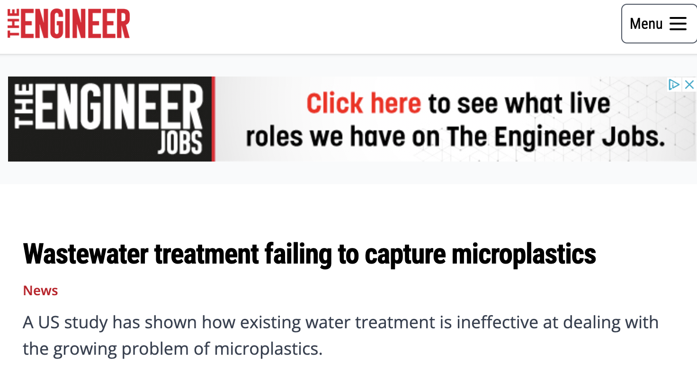
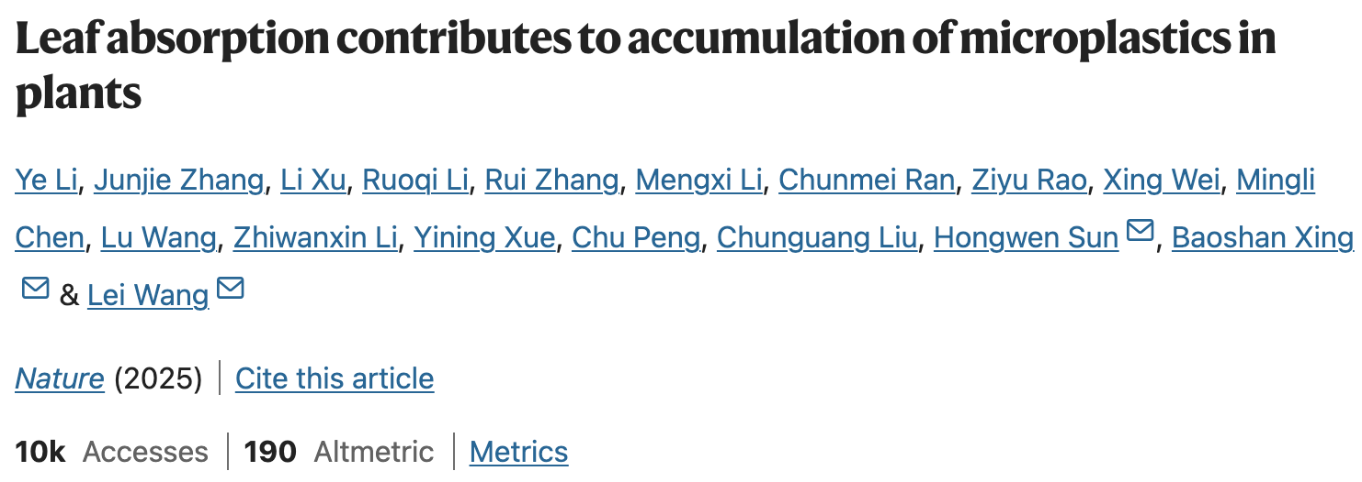
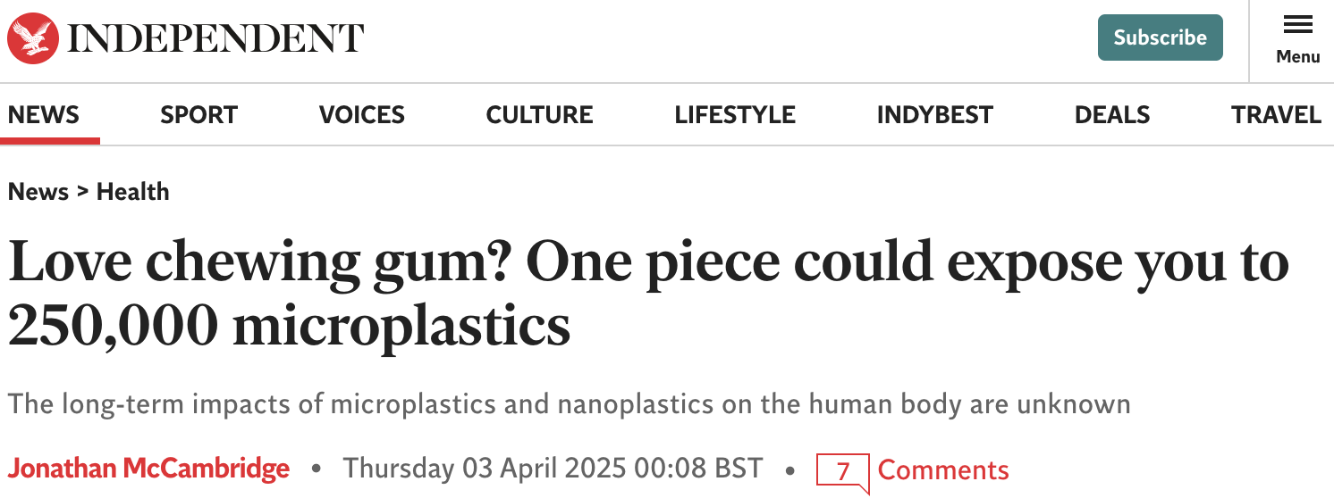
and a major research area…

Slide 26
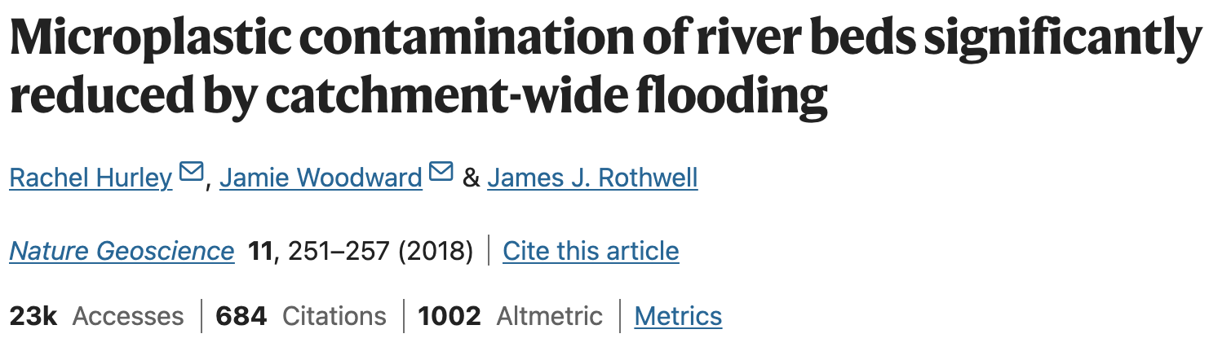
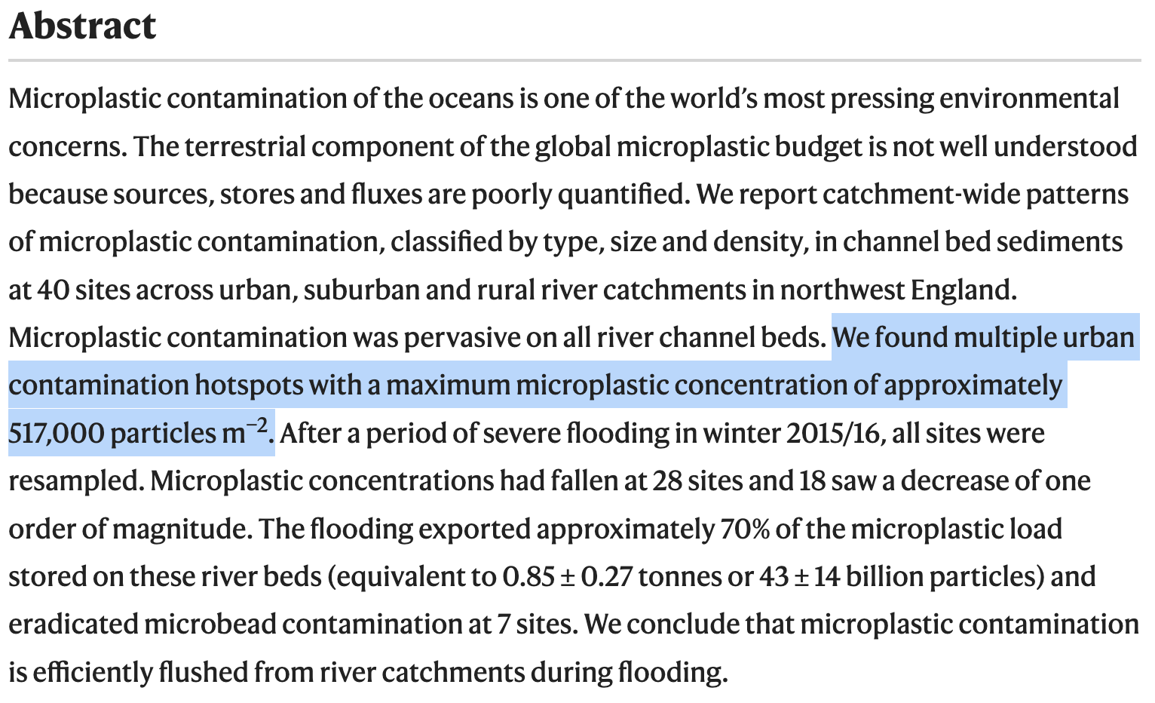
Transport: rivers

Slide 27
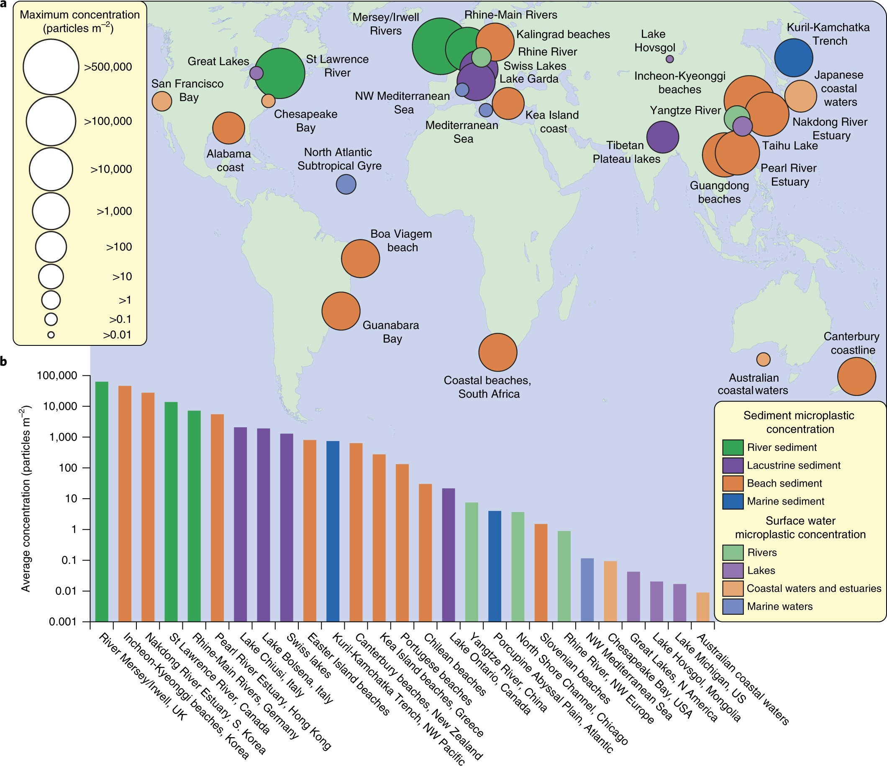
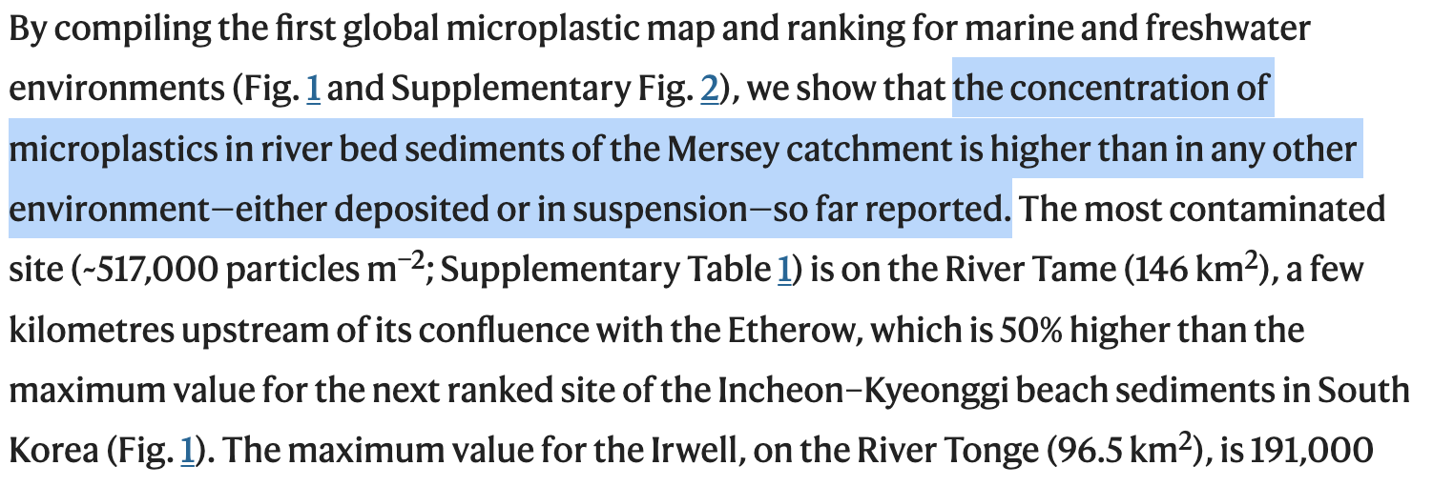
Transport: rivers
Hurley et al 2018

Slide 28
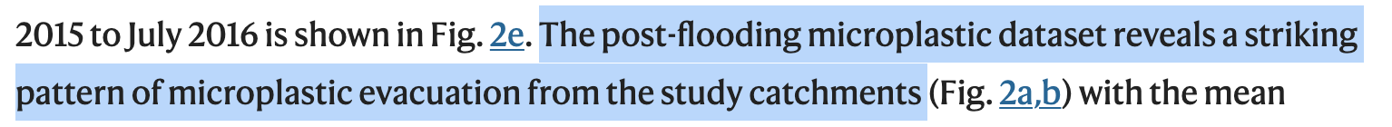
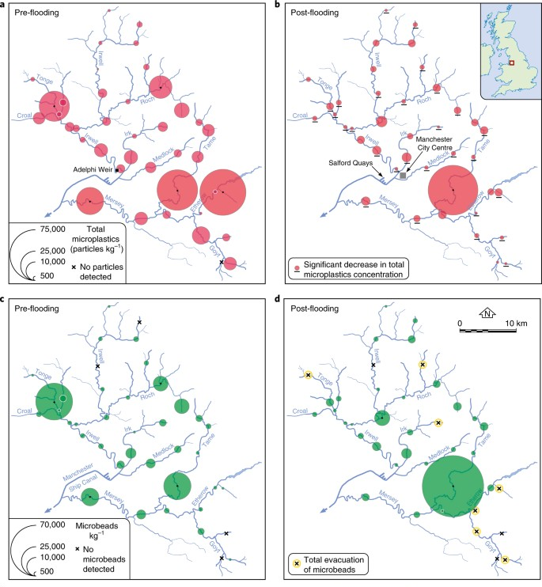

Transport: rivers
Hurley et al 2018
Total microplastics observed in the 2015/16 hydrological year approximate 0.5% of the total floating microplastic burden in the global ocean (4.85 trillion particles)

Slide 29


Transport: oceans
“…we demonstrate that the spatial distribution and ultimate fate of microplastics are strongly controlled by near-bed thermohaline currents (bottom currents). These currents are known to supply oxygen and nutrients to deep-sea benthos, suggesting that deep-sea biodiversity hotspots are also likely to be microplastic hotspots.”

Slide 30



Hadal trenches: the ultimate sink?

Slide 31



Macroplastics: contaminants or pollutants?

Slide 32




Microplastics: contaminants or pollutants?
Microplastics are everywhere, but direct proof of harm is nuanced.
The most convincing evidence comes from lab studies, with a growing but still patchy field evidence base.

Slide 33


Microplastics: contaminants or pollutants?
Microplastics are everywhere, but direct proof of harm is nuanced.
The most convincing evidence comes from lab studies, with a growing but still patchy field evidence base.

Slide 34



Microplastics are Pollutants

Slide 35







Nature-based solutions: microbial degradation?
slow / uncompetitive

Slide 36






Nature-based solutions: microbial degradation

Slide 37





Nature-based solutions: microbial degradation

Slide 38




PETase
Yoshida et al 2016

Slide 39




Nature-based solutions: Mussels as Plastic Filters
Mussels naturally filter microplastics from water
Pilot projects suggest mussel beds can trap and concentrate plastics for easier removal
Low-energy, scalable option — with co-benefits for biodiversity

Slide 40
Towards effective plastic remediation
♻️ A multi-pronged approach is essential:
Waste reduction: Reducing plastic production and single-use plastic consumption
Improved recycling: Mechanical and chemical recycling to recover valuable materials
Active collection efforts: River booms, beach cleanups, ocean plastic interceptors.
🧪 Emerging innovations complement but do not replace core strategies:
Biodegradable plastics offer potential but face scale and stability challenges.
Microbial and enzymatic degradation (e.g., PETase) is promising but not yet sufficient for large-scale environmental remediation.
Combination of reduction, recycling, and recovery is currently the most realistic and effective solution to the plastic crisis.

Slide 41
PFAS
(aka ‘Forever Chemicals’)

Slide 42



What are they?
Synthetic compounds found in firefighting foams, stain-resistant fabrics, non-stick cookware, food packaging
Characterized by extremely strong carbon–fluorine (C–F) bonds

Slide 43

Transport and persistence
Highly mobile: leaches into groundwater and surface waters
Resistant to chemical, biological, and thermal breakdown
Found globally — from tap water to Arctic wildlife

Slide 44



Transport and persistence

Slide 45

Environmental behaviour
Longer-chain PFAS (more carbon atoms) bioaccumulate more strongly
Marine environments generally show higher bioaccumulation than freshwater or brackish systems
Both perfluorocarboxylates (PFCA) and perfluorosulfonates (PFSA) accumulate, but patterns differ slightly by chemical type and ecosystem

Slide 46

Evidence of Harm
Bioaccumulates in human and animal bloodstreams
Linked to cancers (kidney, testicular), immune suppression, thyroid disease (EPA, 2022)
Detected in drinking water, wildlife (even in remote Arctic ecosystems)
Health advisories now recommend near-zero exposure levels
Urgent regulatory and public health responses underway
PFAS are clearly pollutants

Slide 47


Addressing the PFAS issue
Capture technologies: Activated carbon, ion exchange resins
Destruction methods: High-temperature incineration, plasma treatment (expensive)
Nature-Based Solutions (early-stage): Wetland attenuation, sorption into organic-rich soils
Prevention focus: Reducing use and emissions of PFAS at source
No single "magic bullet" — integrated approaches needed

Slide 48
Other emerging contaminants
Plastics and PFAS pollution are just two examples. There are many more, including (but not limited to):
💊 Pharmaceuticals and Personal Care Products
(e.g., antibiotics, antidepressants, sunscreens)
🌸 Endocrine Disrupting Chemicals
(e.g., BPA, phthalates — interfere with hormonal systems)
🧪 Industrial Additives and Plasticisers
(e.g., bisphenol A (BPA), flame retardants, PFAS beyond those covered today)
☠️ Pesticides and Herbicides
(e.g., neonicotinoids, glyphosate — linked to pollinator and aquatic decline)
⚡ Flame Retardants
(e.g., PBDEs — persistent, bioaccumulative, toxic)
🔬 Nanomaterials
(e.g., silver nanoparticles, carbon nanotubes — novel toxicity pathways)

Slide 49
The bigger picture
Plastics and PFAS pollution are key markers and emerging pollutants of the Anthropocene
They contribute to the Triple Planetary Crisis: Climate, Nature, Pollution
Solutions directly align with SDGs:
SDG 6 (Clean Water)
SDG 12 (Responsible Consumption and Production)
SDG 14 (Life Below Water)
SDG 15 (Life on Land)

Slide 50
Key Takeaways
🌍 We are living in the Anthropocene — human activities are reshaping planetary systems
🔍 Emerging contaminants are substances of growing concern; they become pollutants when evidence of harm is demonstrated.
🧪 Plastics (macro and micro):
Widespread, persistent, and fragmenting into microplastics
Recycling is imperfect; solutions require waste reduction, improved recycling, and collection efforts
Nature-based innovations like PETase and mussel filtration are promising but complementary
🧪 PFAS (‘Forever Chemicals’):
Synthetic, highly mobile, and resistant to degradation
Strong evidence of human and environmental harm; bioaccumulate across ecosystems
Urgent need for capture technologies, destruction methods, and nature-based attenuation
🌱 Nature-Based Solutions (NBS) are essential but must complement prevention and innovation strategies
♻️ A multi-pronged approach — reduction, recycling, recovery, and innovation — is needed to tackle pollution and stay within planetary boundaries

Slide 51
5 MIN BREAK

Slide 52

Paper of the Week

Slide 53
ABSTRACT
Environmental exposure to active pharmaceutical ingredients (APIs) can have negative effects on the health of ecosystems and humans. While numerous studies have monitored APIs in rivers, these employ different analytical methods, measure different APIs, and have ignored many of the countries of the world. This makes it difficult to quantify the scale of the problem from a global perspective. Furthermore, comparison of the existing data, generated for different studies/regions/continents, is challenging due to the vast differences between the analytical methodologies employed. Here, we present a global-scale study of API pollution in 258 of the world’s rivers, representing the environmental influence of 471.4 million people across 137 geographic regions. Samples were obtained from 1,052 locations in 104 countries (representing all continents and 36 countries not previously studied for API contamination) and analyzed for 61 APIs. Highest cumulative API concentrations were observed in sub-Saharan Africa, south Asia, and South America. The most contaminated sites were in low- to middle-income countries and were associated with areas with poor wastewater and waste management infrastructure and pharmaceutical manufacturing. The most frequently detected APIs were carbamazepine, metformin, and caffeine (a compound also arising from lifestyle use), which were detected at over half of the sites monitored. Concentrations of at least one API at 25.7% of the sampling sites were greater than concentrations considered safe for aquatic organisms, or which are of concern in terms of selection for antimicrobial resistance. Therefore, pharmaceutical pollution poses a global threat to environmental and human health, as well as to delivery of the United Nations Sustainable Development Goals.

Slide 54


Slide 55

Cumulative API concentrations quantified across 137 studied river catchments (Dataset S6) organized by descending cumulative concentration (ng/L). Percentiles are marked by black lines and countries not previously monitored by crosses above the plot. The cumulative concentrations reported here are calculated as the average of the sum concentration of all quantifiable API residues at each sampling site within respective river catchments.

Slide 56

(A) Detection frequencies (Dataset S5) and (B) number of APIs detected at sampling sites in the global monitoring study (Dataset S4), excluding sites without the detection of any API, and (C) box-and-whisker plots of concentrations (ng/L) of individual APIs (Dataset S4), indicating the mean, minimum, maximum, and upper and lower quartile concentrations for each API globally.

Slide 57

The contaminants with the highest concentrations were paracetamol, caffeine, metformin, fexofenadine, sulfamethoxazole (antimicrobial), metronidazole (antimicrobial), and gabapentin

Slide 58
Massive Range Shifts: Climate change and land use changes will cause about 3,139 mammal species to move their geographic ranges by 2070, especially into high elevations and biodiversity hotspots
Increased Viral Sharing: These shifts will result in at least 4,000 new opportunities for cross-species viral transmission
Human Risk: New hotspots of viral sharing are expected to overlap heavily with human population centers, especially in Asia and Africa, raising the risk of zoonotic (animal-to-human) disease spillover
Role of Bats: Bats are projected to drive the majority of novel viral transmissions due to their high mobility and evolutionary tendencies
No Easy Fix: Even limiting global warming to under 2°C will not significantly reduce the risk of viral sharing, because species' range expansions will still occur under moderate warming
Call to Action: The authors stress the need for viral surveillance programs to be paired with biodiversity monitoring, particularly in tropical regions where most emerging diseases originate
Climate change is already setting in motion ecological changes that will heighten the risk of pandemics, and urgent, global cooperation in monitoring wildlife and viruses is necessary to prevent future outbreaks

Slide 59
Discuss:
Why is pharmaceutical pollution a problem for humans and nature?
What are the major sources, and how could we minimise them?
How could we harness nature to help clean up pharmaceutical pollution?

